Slide 1
Trex Consumer Recycling
Town Run Watershed Group

Slide 2
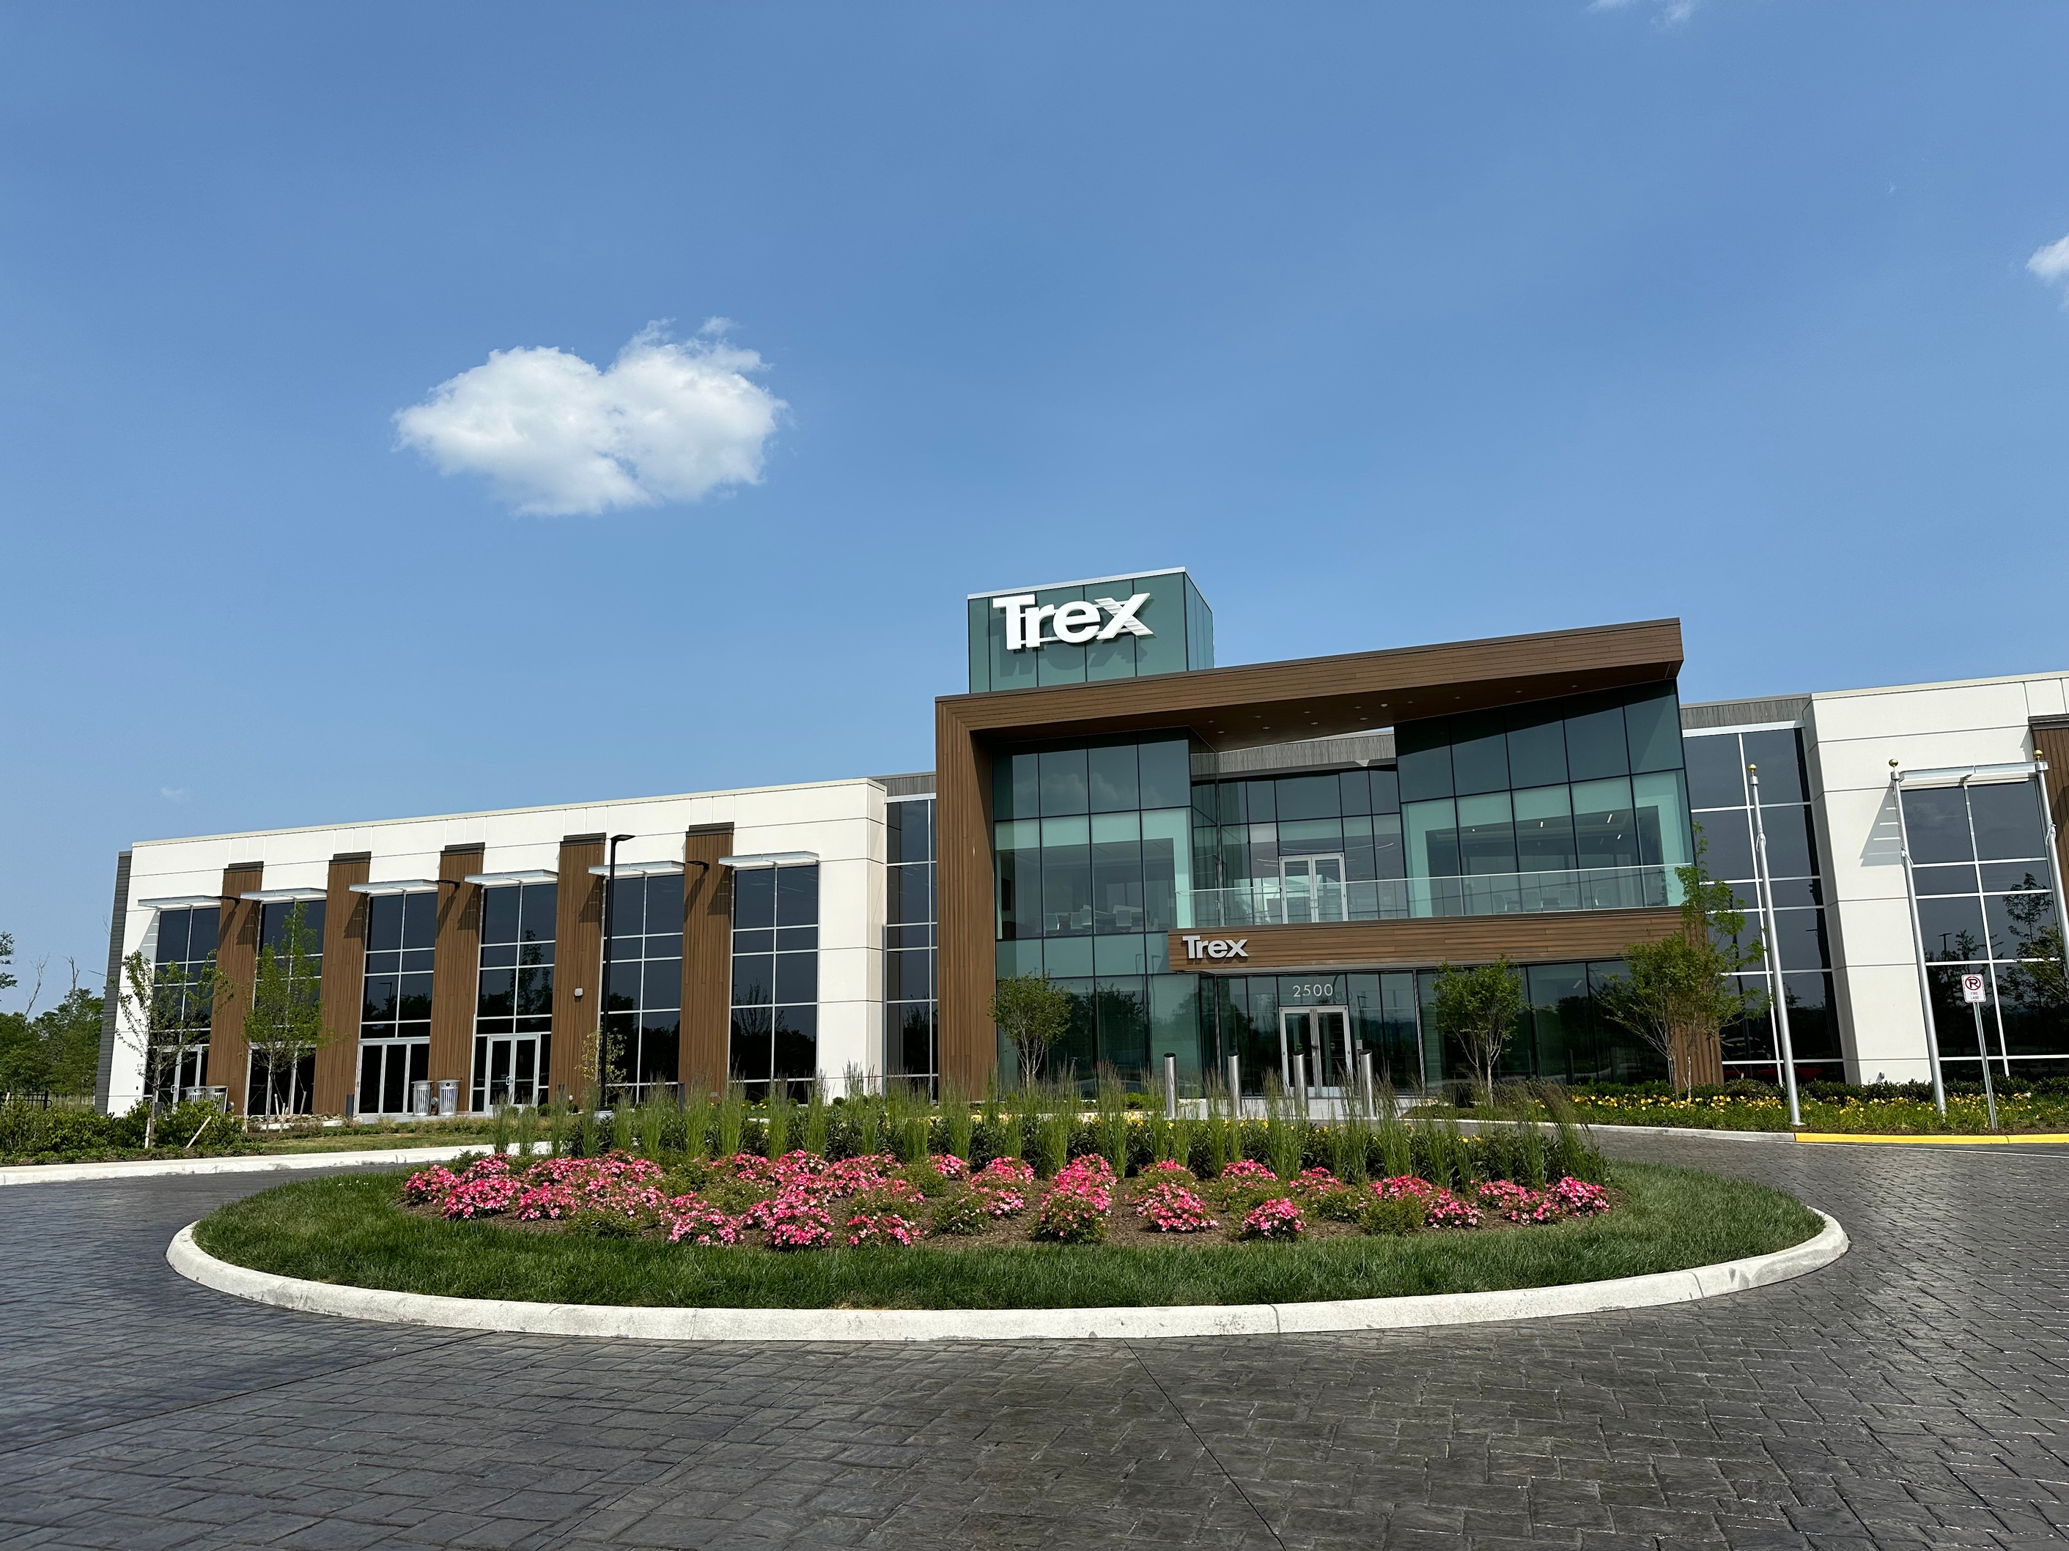




WHO WE ARE
Trex invented the composite decking category in the early 1990s. Since then, we’ve been building and innovating to become the world’s #1 decking brand. But the Trex story doesn’t stop there.
We’re always working on what’s next.
WINCHESTER, VA
FERNLEY, NV
LITTLE ROCK, AR
Corporate Headquarters
Manufacturing
Distribution
Warehousing
Manufacturing
Distribution
Poly Operations 2025
Decking Jan 2027
Plus remote team members amplifying the Trex brand and mission across the country and internationally
Notes:
Let’s learn more about the company you have just joined.
We have 3 major locations.
Winchester Plant & Facilities – about 1400 plant employees
HQ – 200+ employees
Fernley is 400 employees
Little Rock – handful of employees focused on getting the plant built and staffed – when this is fully up and running will be 400 – 600 employees

Slide 3
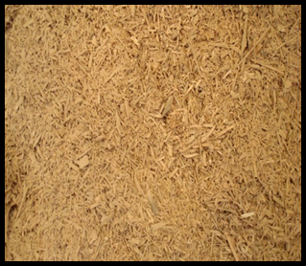
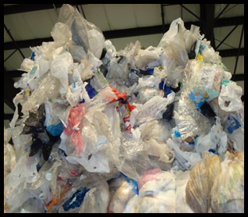
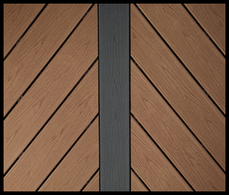


Ingredients
Trex decking boards are made from recycled polyethylene bags/wraps/films/packaging and wood waste & co-products (chips & sawdust)
    The wood is a co-product (dust & chips) from flooring and cabinet manufacturers and waste from commercial/agricultural operations (pallets & tree waste)
    The polyethylene film comes from various commercial and community resources

Slide 4
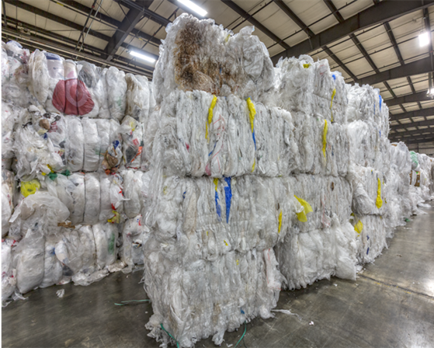
Recycling Facts
Upcycled approximately 400 million pounds of plastic film and 650 million pounds of recycled wood in 2024
Coordinates 3800+ school and community recycling programs
2.9 million pounds of plastic bags/film upcycled by Trex in 2024 through our community and school programs
NexTrex consumer program has a network of approximately 32,000 retail collection points in the U.S. and Canada

Slide 5
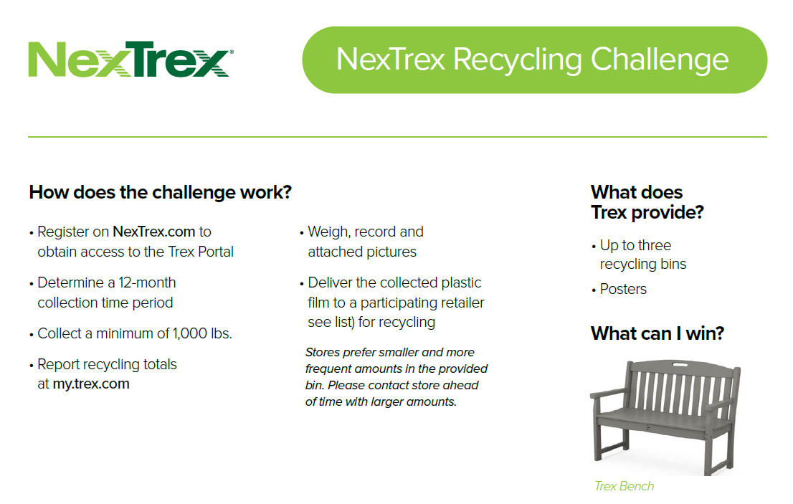

Slide 6
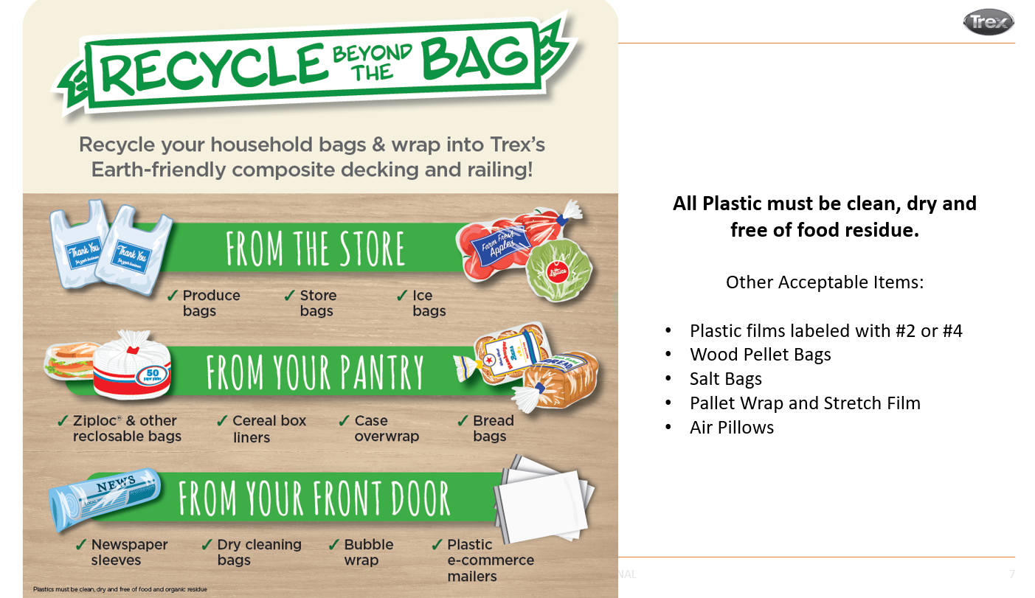

Slide 7
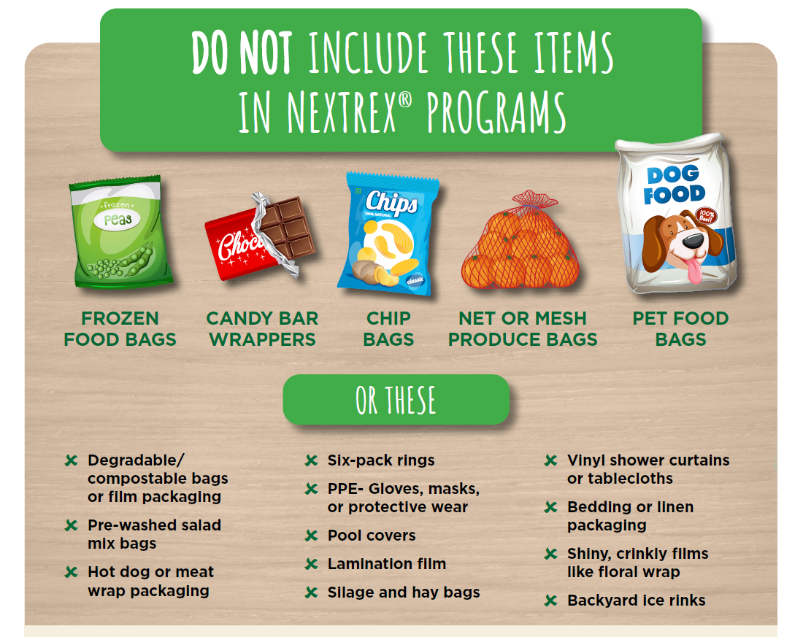

Slide 8
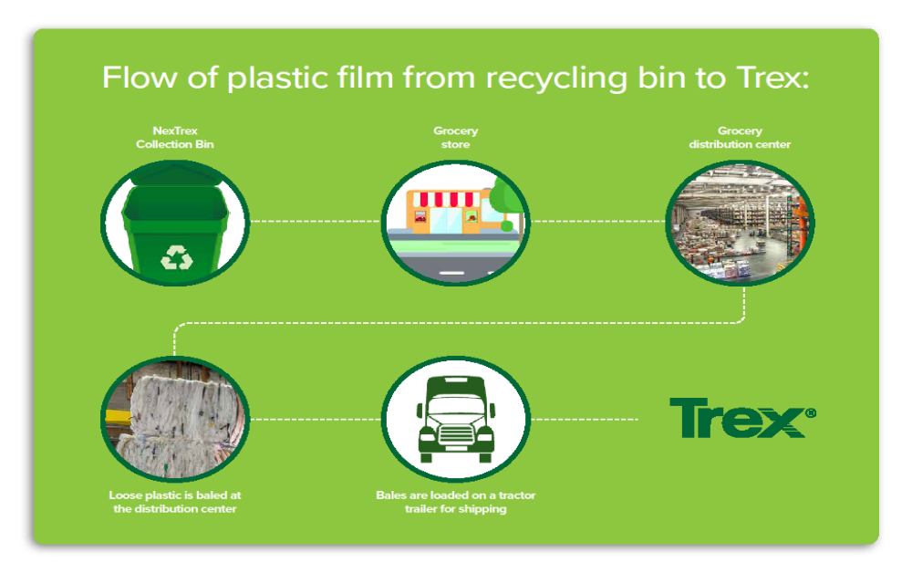

Slide 9

